Slide 1
Forensic Toolkit Analysis
Casey Preston Brandon

Slide 2
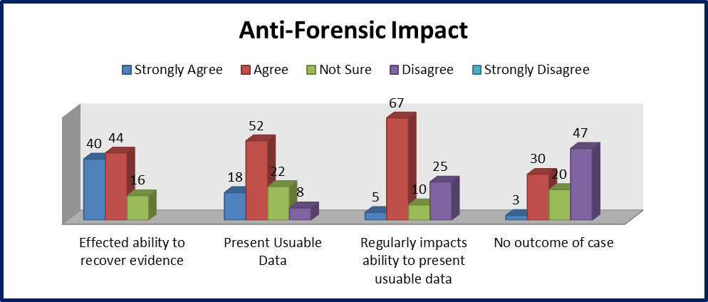
Beer, Richard. Anti-Forensic Tool Use and Their Impact on Digital Forensic Investigations: A South African Perspective. The Proceedings of the International Conference in Information Security and Digital Forensics, Thessaloniki, Greece, 2014.

Slide 3
Research - Hidden
Alternate Data Streams - Macintosh files, Windows Attributes
“type c:\anyfile.exe > c:\winnt\system32 \calc.exe :anyfile.exe”
Timestamp

Slide 4
Research - Hidden
Steganography - In Plain Sight
Inject into carrier files
OpenPuff and Xiao tools

Slide 5
Research - Hidden
Slack Space - Unused space in an allocated block
Wanted Slacker
Used PEBrowse and HexEditor

Slide 6
Research - Destroyed
CCleaner - popular freeware cleaner
Sdelete - command line file deleter, from Microsoft
Eraser - 13 different methods, ones I used were US Air Force 5020, and Schneier seven pass

Slide 7
Research - Altered
Meta Data Manipulation
AttributeChanger 8
Timestamps
File Attributes

Slide 8
Research - Altered
File Format Modification
Hex Editing
File Signature
File Extensions

Slide 9
Research - Altered
Encryption
VeraCrypt
Keyfile
Hidden Volumes
plausible deniability

Slide 10
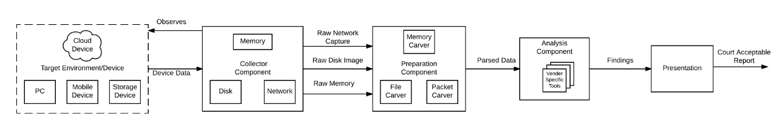
Component Diagram

Slide 11
User Story - 1
As a Computer Forensic Analyst, I want to detect and recover hidden data so I can spot trails of evidence
AC 1.1: Using the digital forensics tool, the location of data hidden within the context of the system can be identified.
AC 1.2: Using the digital forensics tool is able to recover data hidden within a given location.

Slide 12
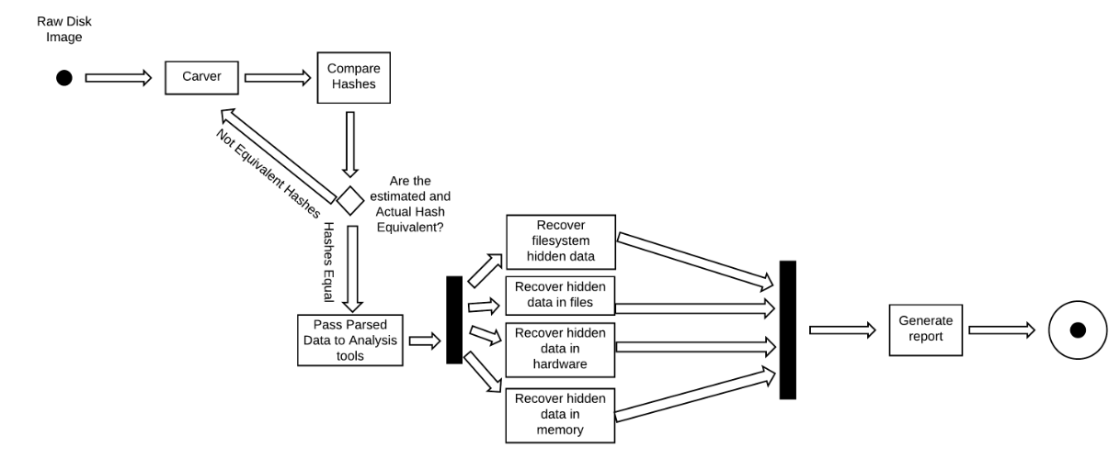
Activity Diagram - 1

Slide 13
User Story - 2
As a Computer Forensic Analyst, I want to detect and recover deleted data so I can support/define a suspect's intent
AC 2.1: The digital forensics tool is able to detect all files whose pointers have been deleted and have not been completely overwritten in the file system.
AC 2.2: The digital forensics tool is able to recover all portions of a file that have not been overwritten in the file system

Slide 14
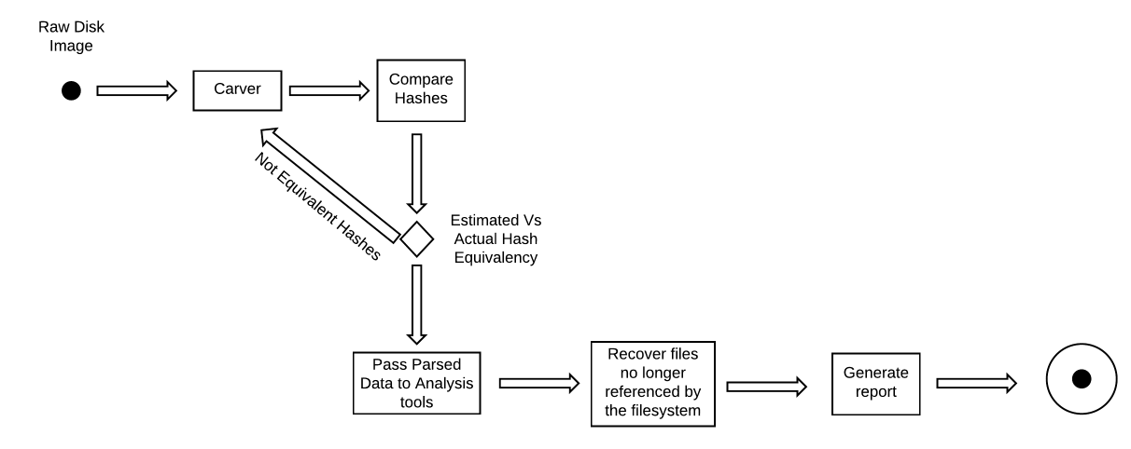
Activity Diagram - 2

Slide 15
User Story - 3
As a Computer Forensic Analyst, I want to identify and understand system contents so I can develop an overview of user activity
AC 3.1: The digital forensics tool is able to retrieve user files and permissions, while also retrieving usernames and user activity logs.

Slide 16
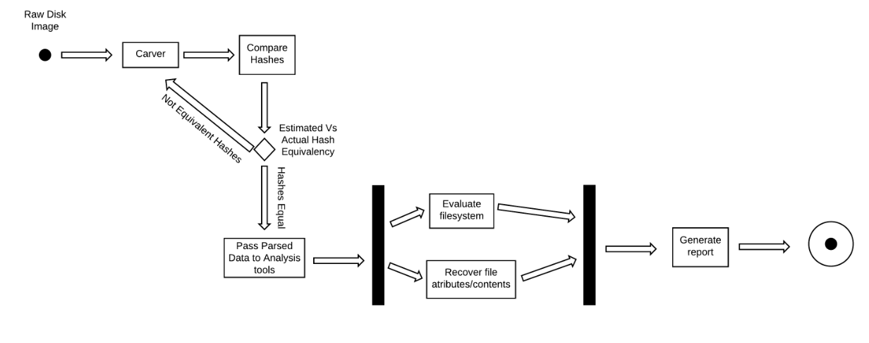
Activity Diagram - 3

Slide 17
User Story Realization
https://github.com/cbranan/Anti-Forensics/blob/master/README.md#user-story-realization

Slide 18

Questions?

